Slide 1
Representing Which Schools Have the Most Return on Investment
By: Sean Lee

Slide 2
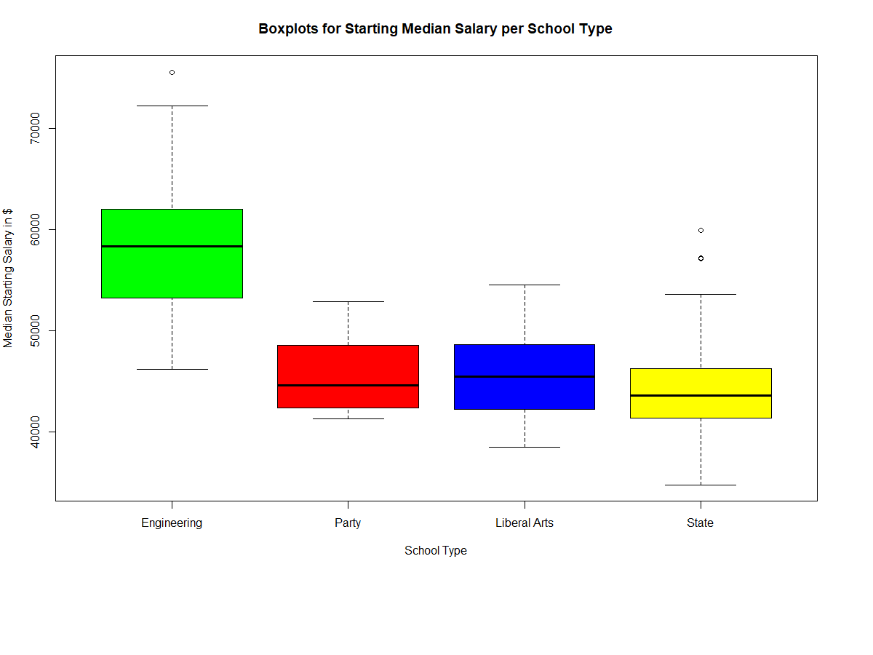
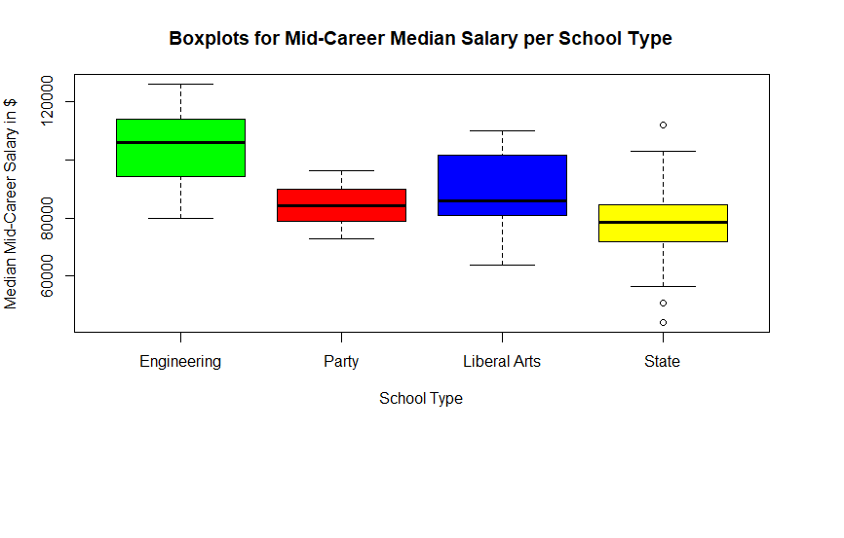
What type of College Has The Best Salary:
By using data visualization we are able to see that the college type with the best salary are Engineering schools
Even Mid Career, the median salary for students from Engineering schools is considerably higher than for other schools.
Party, Liberal Arts, and State schools all have relatively the same median salary for both starting and mid career
Engineering schools have the most variance in terms of starting and mid career median salary

Slide 3
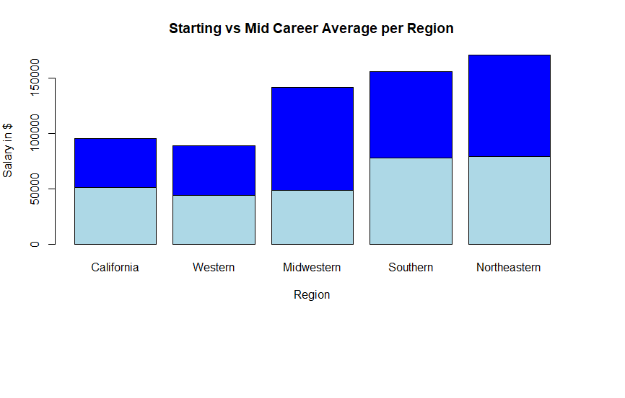
Which Region Has The Best Salary:
Northeastern schools and Southern schools have the best starting median salary average
Northwestern schools seem to be the overall best choice as they have the best starting and mid career median salary average
California, Western, and Midwestern schools all have relatively the same starting median salary, however Midwestern pulls ahead greatly when it comes to mid career median salary average

Slide 4
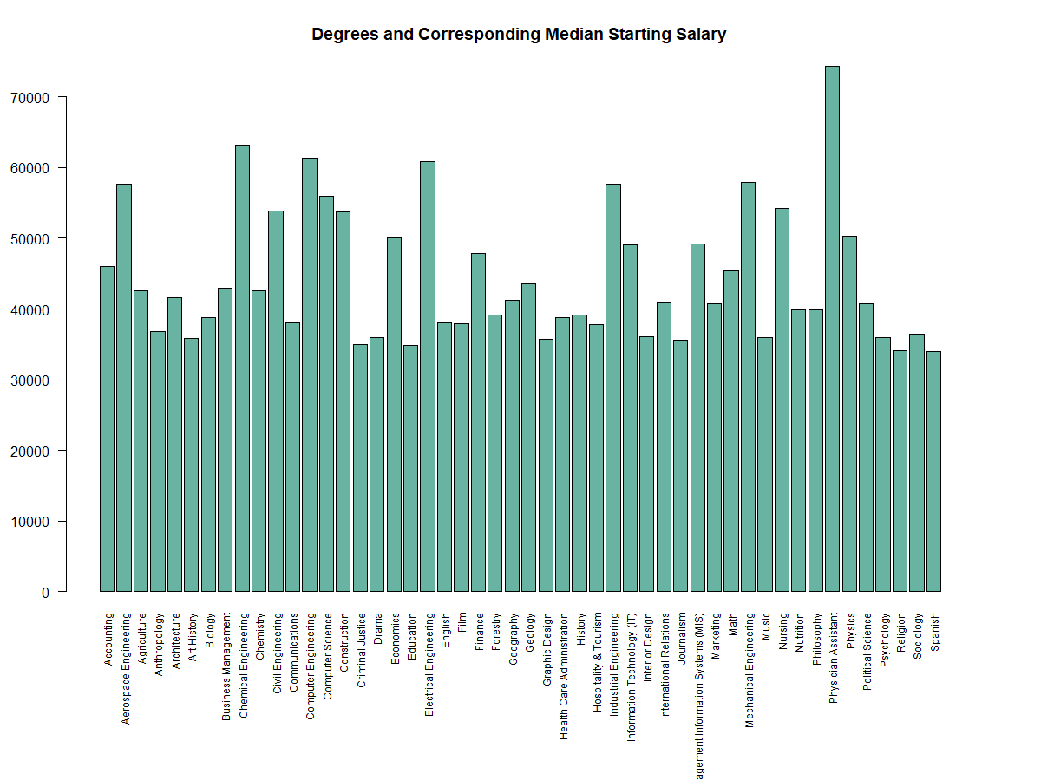
Which Degrees Are The Most “Bang For Your Buck”:
The best majors for a starting salary are usually STEM related, however the best is being a Physician Assistant
Any sort of engineering major is in the upper tier of majors that have a good return on investment
Religion and spanish are the standout majors with the lowest median starting salary

Slide 5
Applications of Dataset and Reliability:
The data visualizations provided today help to illustrate which colleges and majors are the best in terms of starting and mid career median salary
The dataset used may be biased because there were only 50 majors included
The dataset is also 5 years old meaning that some of the data may be outdated
Values inside the dataset also only pertained to salary information, more information could have been provided on factors such as cost of attendance and student amenities to paint a better picture on which colleges are worth looking at
Since the dataset is provided by the Wall Street Journal (a reputable newspaper), it is unlikely that the data is skewed in favor of any one particular college
These data visualizations can be extended to include community colleges, nursing schools, and other higher education institutions, even ones outside of the US

Slide 6
Sources:
https://www.kaggle.com/wsj/college-salaries

